Slide 1
registration
Eng . Mahmoud ragab

Slide 2
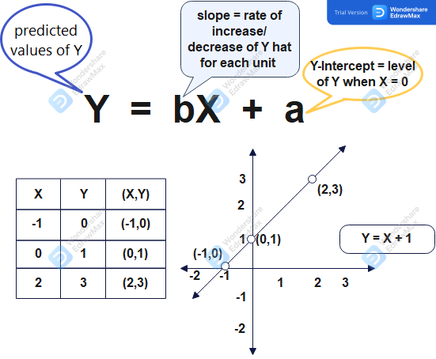
linear regression equation

Slide 3
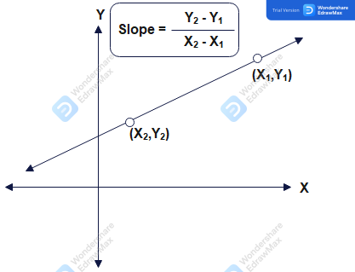
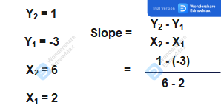

Slide 4
inputs
X
Outputs
Y
Rows
M
Features
N
Hypothesis
h (X)
Cost Function
J
Theta

Slide 5
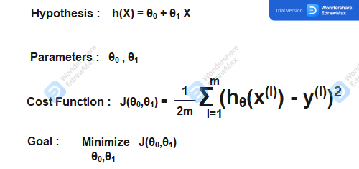
The goal is to reduce the difference between the expected value “h( x )” from the linear equation and the real value “y”
Divide by “2m” to relate the error value to the number of values in the sample
The goal is to find the value of θ₁ and θ₂, which makes the “j” )error value( as small as possible

Slide 6

x | Y | H(x) | H(x)-Y | h(x) – Y²
1 | 7 | 7 | 0 | 0
2 | 8 | 9 | 1 | 1
2 | 7 | 9 | 2 | 4
3 | 9 | 11 | 2 | 4
4 | 11 | 13 | 2 | 4
5 | 10 | 15 | 5 | 25
5 | 12 | 15 | 3 | 9
Θ_{0 = 5 ,} θ_{1 = 2 , H(x) = 5 + 2x}
J = (0+1+4+4+4+25+9) / 14
J = 47 / 14 = 3.3

Slide 7
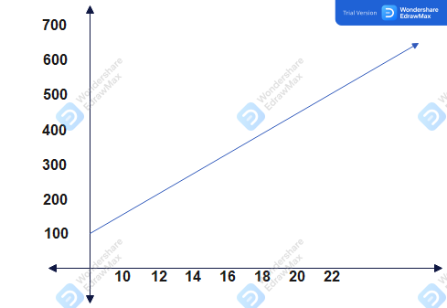
Best fit line

Slide 8
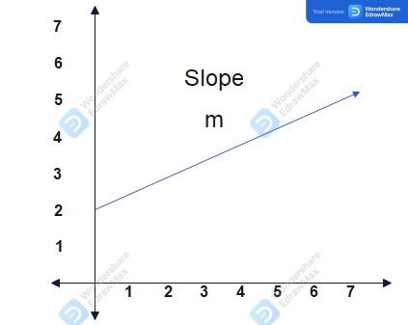
Straight-line equation
Y
Y = mx + c
Y-intercept “C”
X

Slide 9
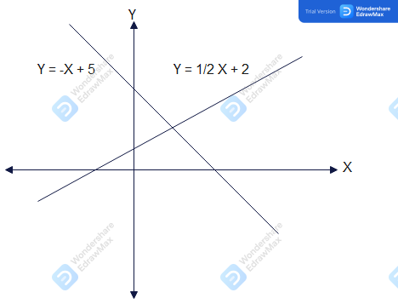

Slide 10
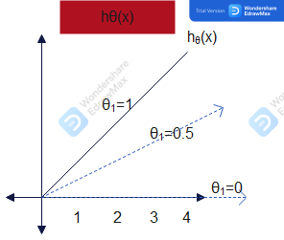
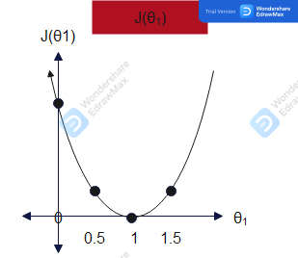
Determine the value of theta “θ”

Slide 11

any questions ?

